Slide 1


DATA SCIENCE FOR CYBER SECURITY
By
Saranraj Kumar
Motis 9

Slide 2



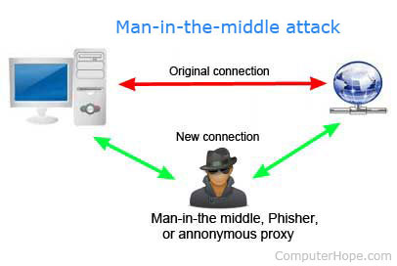

Few problems in cyber security
Malicious external/internet threat (Phishing, Ransomware, etc.)
Large Scale Attacks (DDoS, Spam campaign, etc. )
Data Loss (Data Ex-Filtration)
User Behavioral Analytics (user login)

Slide 3
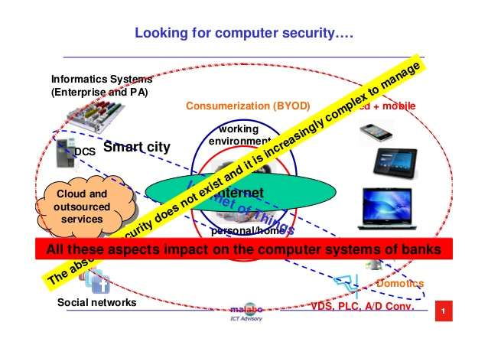

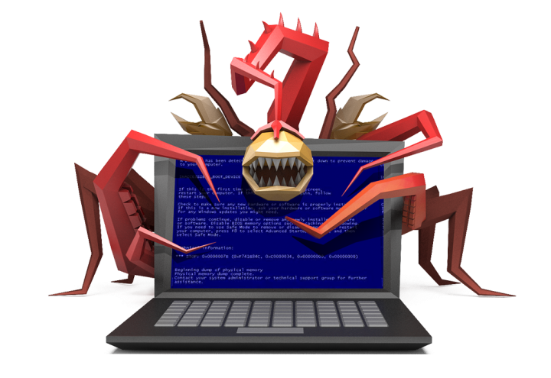
Current Operation Model
Collect
Detect
Investigate
Respond

Slide 4
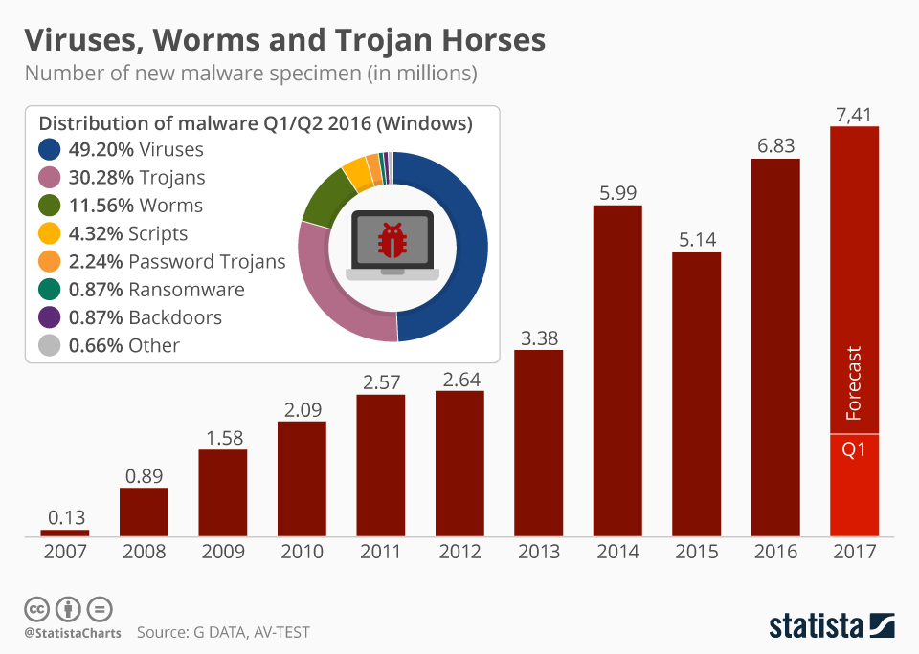
Cost of Cybercrime on the Rise

Slide 5





Current Approach is failing

Slide 6
What’s happening? Why?
Security Operations are slow
Reactive operation
Skill Gap
Defending the perimeter no longer enough with mobile, cloud, IoT

Slide 7
Why Data science for security?
Security is a Big Data problem
We have the data, We know the goal (Security) ….. Data Science is the art of solving business problems by utilizing data in hand.
Leveraged Data Science to show use cases analyzing their active directory data, identifying fraud, unapproved file sharing, et
Find the Unknown
The attackers operate from known environment and their job is more predictable.

Slide 8
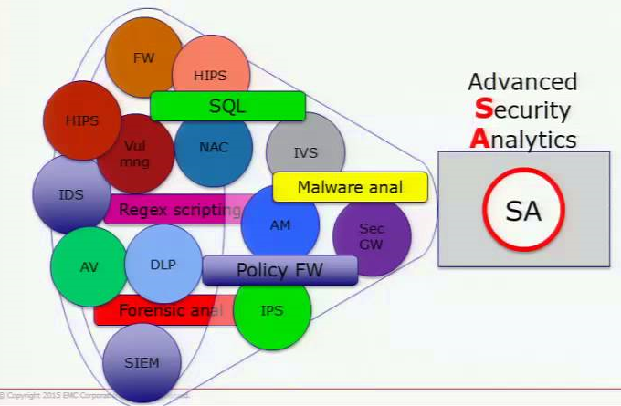
It’s time for next era- Advanced Security Analysis
Comprehensive
Accurate
Proactive
Faster
Context Awareness
Adaptive

Slide 9
Data Sources
Endpoints: Processes, applications, host-based IDS alerts, file system changes, registry changes, operating system logs, anti-virus alerts.
Network: Network packets and flows, network IDS/IPS alerts, network topology, firewall logs, HTTP proxy logs, DNS logs, Netflow, Bro logs.
Authentication: Windows/Mac/Linux authentication logs, Windows security logs, Active directory logs, Privilege user management logs.
Threat Intelligence: Indicators of compromise, malicious domain names, IP addresses from peer organizations and open source communities, malware signatures.
Asset management logs
Vulnerability logs

Slide 10

Suspicious User Activity
User: John
Country: UAE
-------------------------------------
Risk Score : Increases time to time based on the activity
John
UAE
19-02-2018
Alice
Netherlands
Bob
UK
Frank
France
Debby
Germany
Rose
Denmark
20-02-2018
21-02-2018
22-02-2018
23-02-2018
24-02-2018

Slide 11
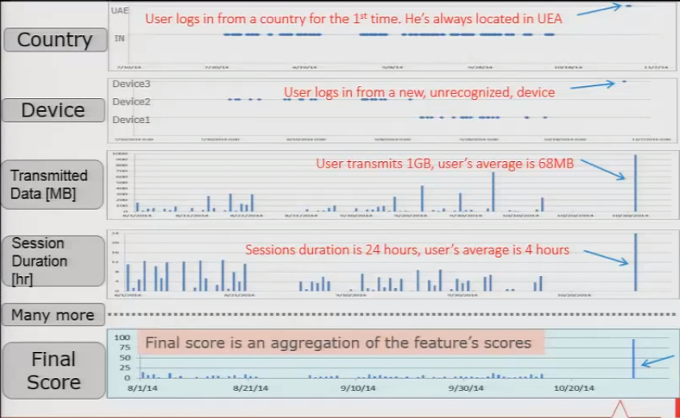
Detecting a suspicious VPN login
User: John
Country: UAE
Score
10
15
30
40
95

Slide 12
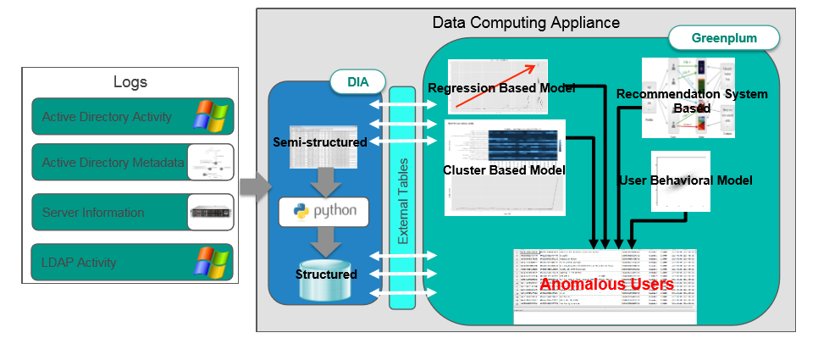

Suspicious User Activity

Slide 13
Applications of Data Science-led Techniques for Security
Microsoft uses powerful Data Mining Systems to identify Security Threats
The cyber security arm RSA of the US big data company EMC uses machine learning and advanced big data analytics methodologies to prevent online fraud
European Government develops POLE Data Model to Store and Record Incidents

Slide 14
References
TechGig Webinar, Demystifying Security Data Science – Part 1
TechGig Webinar, Demystifying Security Data Science – Part 2
https://www.kdnuggets.com/2015/12/big-data-science-security-fraud-detection.html

